Slide 1

Object Detection
Object detection
deeplearning.ai

Slide 2
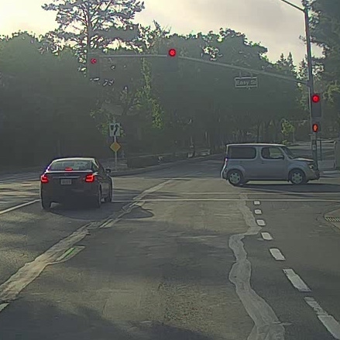

Car detection example
Training set:
x
y
1
1
1
0
0

Slide 3
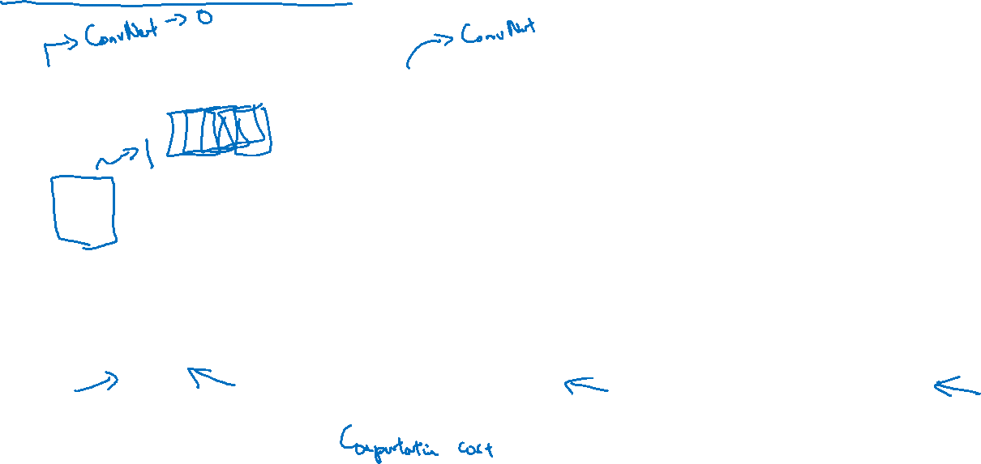
Sliding windows detection

